Slide 1
Physical Exam Findings for DKA Patients as a Predictor for Severity of GCS/Cerebral Edema
Nate Hayward
Joshua Kawasaki
Andrea Stofko

Slide 2
Background
Overview: Diabetic ketoacidosis (DKA) is a severe complication caused by untreated/poorly managed diabetes.
Insufficient insulin levels prevent glucose from entering cells, causing generation of ketone bodies, which accumulate and lead to metabolic acidosis.
Clinical context: Severe DKA can lead to neurological impairment, abnormal breathing (e.g., Kussmaul respirations), persistent vomiting, or dehydration, requiring urgent clinical intervention.
Complications:
electrolyte imbalances (e.g., hyponatremia and hypokalemia), cerebral edema, cardiac arrhythmias, acute kidney injury, multi-organ failure, coma, or death.
Current gap in research: 30% of newly diagnosed diabetic pediatric patients initially present in DKA.
Predicting which patients will require escalation of care remains challenging and highlights the need to identify the most informative physical exam findings.

Slide 3

Objective
Create predictive models to understand what physical exam findings are strongly associated with disease progression, specifically focusing on:
Patients requiring imaging
Cerebral edema
Escalation of care (marked by an extended overnight stay)
Altered mental status (described as a GCS score below 9)

Slide 4

Data cleaning and preparation
Data was obtained from the Pediatric Emergency Care Applied Research Network (PECARN) database. Our analysis uses the “Fluid Therapy and Cerebral Injury in Pediatric Diabetic Ketoacidosis (Fluid Therapy in DKA)” dataset.
Data cleaning:
Consulting specialists
Regular expression analysis
One-hot encoding
Merging/pivoting of data frames
Data preparation:
SMOTE to balance training data

Slide 5
Model Development and Evaluation
Logistic Regression models were developed to determine which physical exam findings were most predictive of our outcomes of interest.
Models were evaluated using:
Confusion matrices
AUC-ROC plots
Calibration plots
Models with high performance:
Imaging
GCS score*
Cerebral edema*

Slide 6
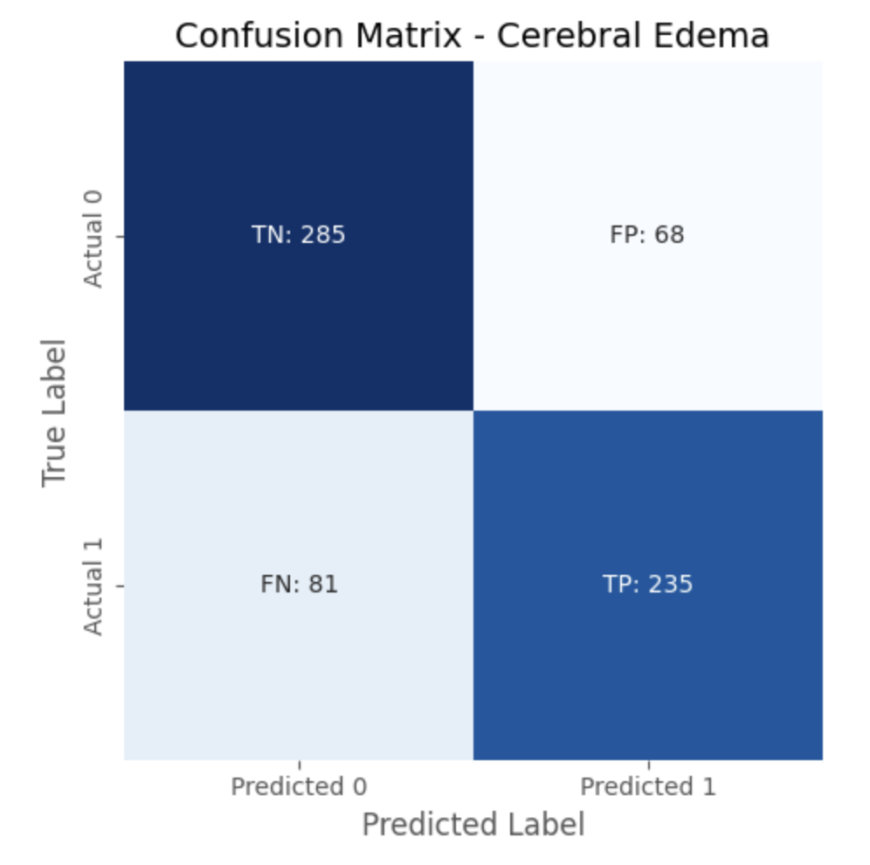
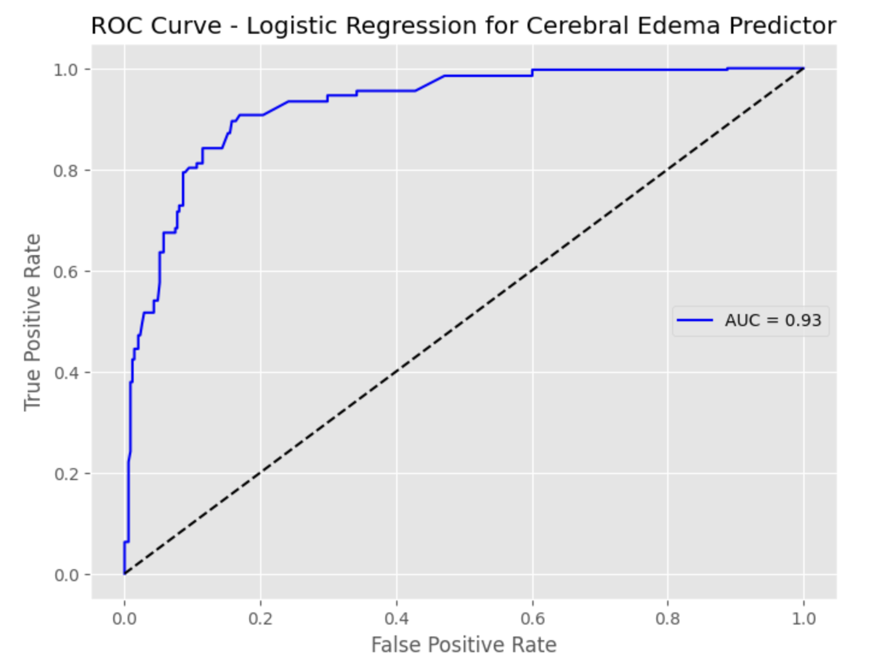
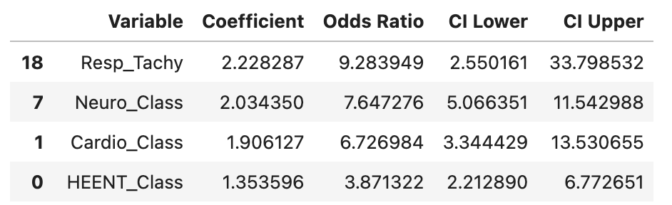
Results – Predictor for cerebral edema
Notes:
Confusion Matrix results:
Precision: Of those that were predicted to be positive by the model, how many were actually positive?
Recall: Of the values that are actually positive, how many did the model correctly identify? Precision = 0.80
Recall = 0.75
AUC-ROC: Demonstrates the ratio of True positive predictions to false positive predictions at different thresholds

Slide 7
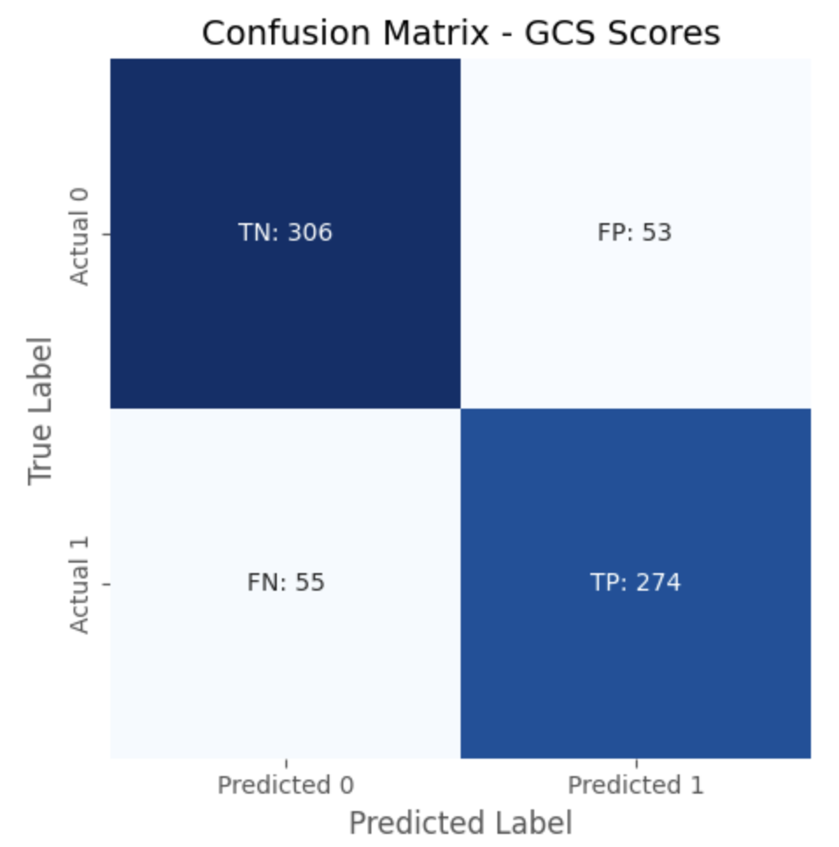
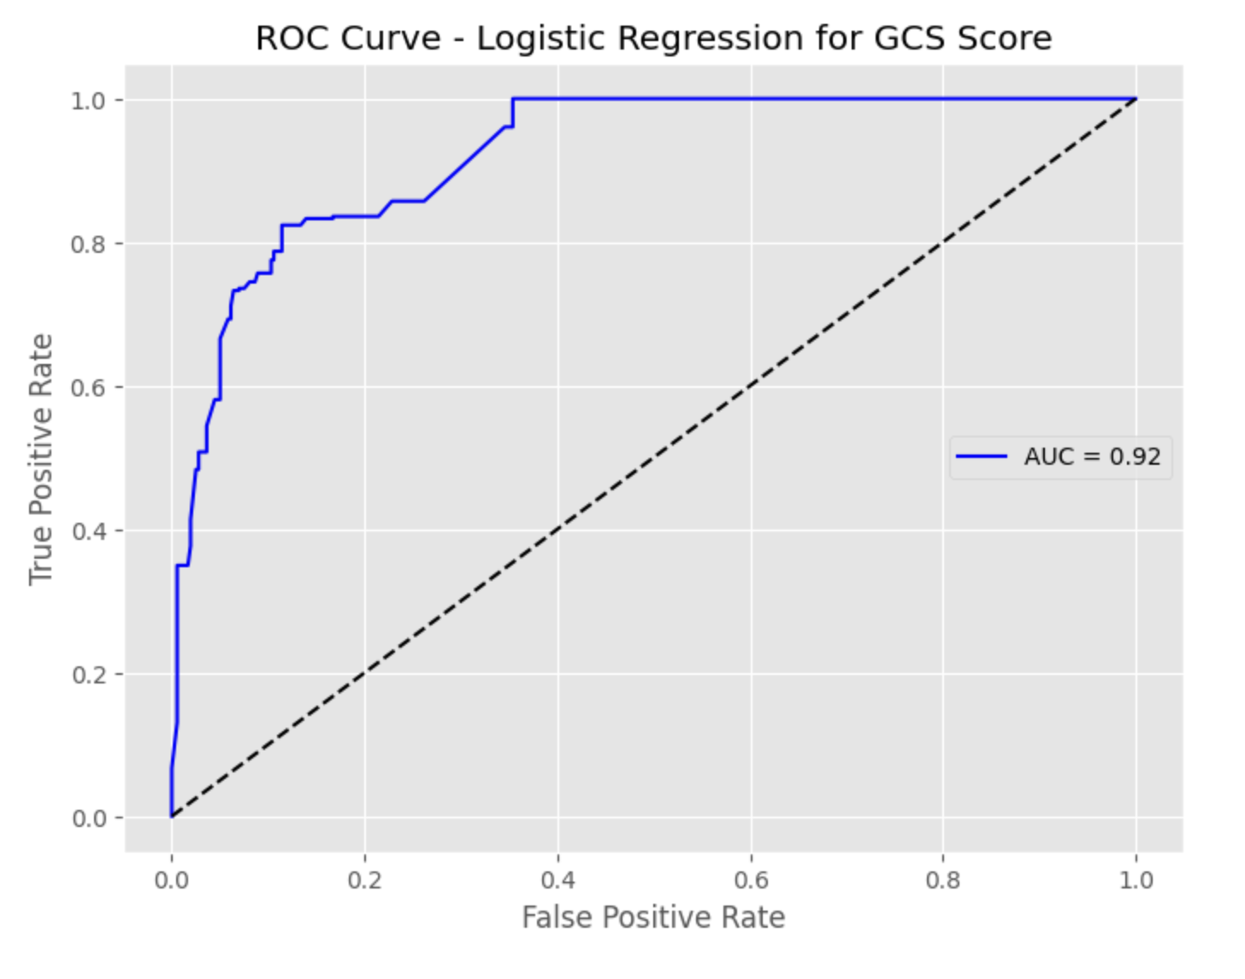
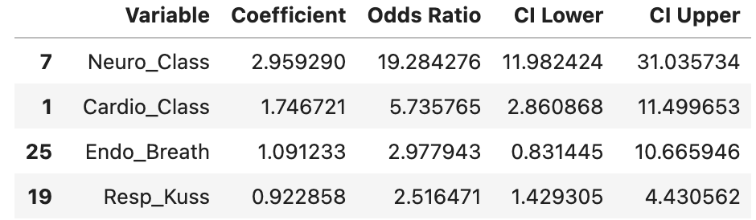
Results – Predictor for decreased gcs score
Notes:
Precision = 0.84
Recall = 0.83

Slide 8
Conclusions
Variables most associated with outcomes:
Tachypnea
Abnormal neurological exam
Abnormal cardiovascular exam
Abnormal HEENT findings
Clinical Context/Relevance
Combination of the above findings may suggest increased potential for escalation
Closer monitoring may be warranted for patients exhibiting this constellation of symptoms
In lower resource settings, without the benefit of frequent lab monitoring or imaging, these exam findings may help guide care and associated intervention

